Slide 1
LDRD 06501601:
Multi-Physics Engineering Tool for Wind-Plant Design and Analysis
Project Update Meeting
PI: Jason Jonkman
April 21, 2016

Slide 2
Staff Planning
Team Members | FY16 FTE Months | FY16 FTE Hours
Matt Churchfield (NWTC) – SOWFA for tool development & V&V | 0.50 | 76
Paul Fleming (NWTC) – Controls | 0.20 | 30
Pieter Gebraad* (NWTC) – Tool development, V&V, & controls | 0.70 | 106
Bonnie Jonkman† (NWTC) – Programming support | 1.50 | 228
Jason Jonkman (NWTC) – PI, tool development, & V&V | 3.50 | 532
Sang Lee (NWTC) – SOWFA for tool development & V&V | 2.40 | 365
Pat Moriarty (NWTC) – Advisor | 0.10 | 15
Avi Purkayastha (CSC) – Programming support | 0.75 | 114
Qi Wang (NWTC) - SOWFA for tool development & V&V | 1.00 | 152
Total | 10.65 | 1618
*Pieter Gebraad’s hours will be transferred to Jennifer Annoni
†Some of Bonnie Jonkman’s time will be transferred to Greg Hayman

Slide 3
Gantt Chart
Gantt Chart of Proposed Activities, with Milestones & Dates

Slide 4
Recent Progress on Approach
Identified software name: FAST.Farm
Initiated SOWFA simulations to support model development
Chose to rely more on DWM, rather than FLORIS/FLORIDyn:
Solve wake deficit based on the thin-shear-layer approximation to axisymmetric Navier-Stokes instead of a smoothed version of FLORIS/FLORIDyn’s stepped wake
Neglect (at least for now) wake skew as a result of veer
Address many of DWM’s limitations
Developed a submodel hierarchy & initiated detailed plans

Slide 5
Limitations of DWM to be Addressed
Limitation* | Solution
Ambient wind solved per individual rotor, based on Taylor’s frozen-turbulence assumption, not coherent across wind farm or based on mesoscale conditions or local terrain | Compute ambient wind farm-wide from ABLSolver
No treatment of a wind farm super controller | Include a wind farm super controller
Wake advects at mean ambient wind speed, not accelerating from near wake to far wake or affected by local flow conditions | Advect wake based on local spatial-averaged ambient wind speed & wake deficit
Wake deficit not distorted by inflow skew (i.e. when looking downwind, the wake looks circular, not elliptical) Wake centerline not deflected by inflow skew | Solve wake deficit in planes parallel to rotor disk Deflect wake centerline based on inflow skew
Wake deficit & centerline based only on mean conditions, not updated for transients in inflow, turbine control, or turbine motion (for FOWT) | Update wake deficit & centerline based on low-pass filtered inflow, turbine control, & turbine motion
Turbine & wake dynamics solved individually or serially, not considering two-way wake-merging interactions Wake impingement based only on strongest wake deficit, not considering cumulative effects from multiple upwind turbines, &/or wake impingement approach treated differently below & above rated wind speed (i.e. a discrete change) No method to calculate disturbed wind in zones of wake overlap | Solve individual turbine & wake dynamics in parallel on multiple cores, interconnected through MPI Allow wake merging to influence wake dynamics Calculate wake deficits of downwind turbines dependent on impingement of wakes from upwind turbines Superimpose wake deficits in axial direction based on root-sum-square method
Wakes meander laterally, but not axially | Meander wakes both laterally & axially
*Several variations of DWM have been implemented (by DTU, DNV-GL, UMass, etc.); the exact limitations depend on the implementation

Slide 6
FAST.Farm Submodel Hierarchy
Not currently planned;
perhaps consider in
future

Slide 7
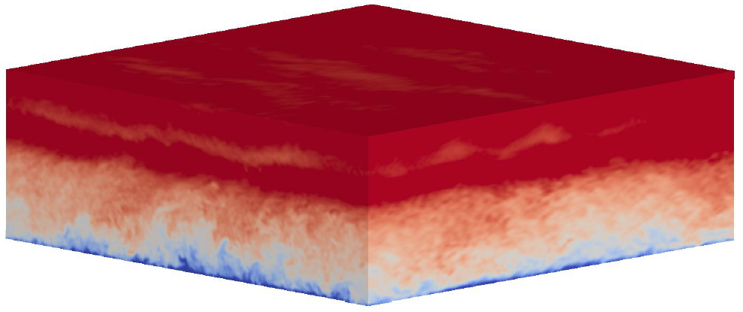
Ambient Wind
Processes ambient wind across wind farm from a precursor ABLSolver simulation
Need 3D wind data where wakes may reside:
Will be spatially averaged across wake planes, so only need low resolution
Need higher resolution around rotor(s)
Ambient Wind
States:
N/A
Parameters:
Spatial discretization
Ambient wind speeds from precursor ABLSolver simulation
Outputs:
Ambient wind speed throughout domain
Ambient TI
Inputs:
N/A

Slide 8
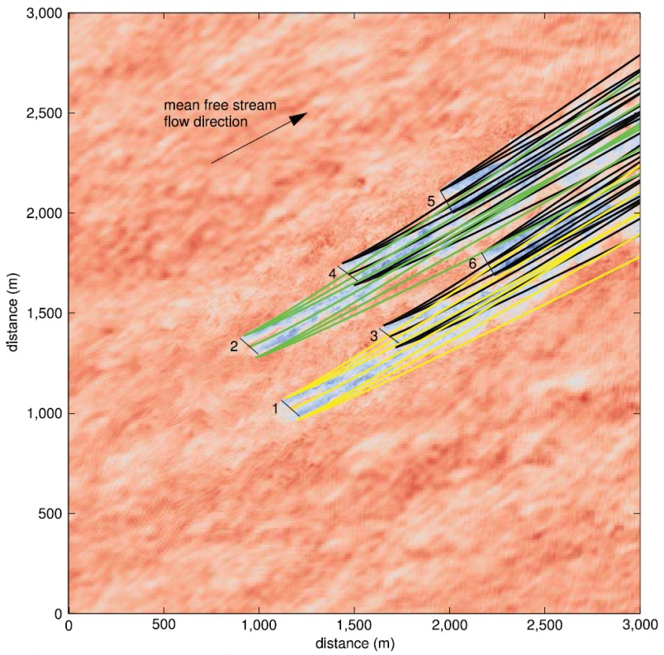
Super Controller
Solves wind farm super controller dynamics
Perhaps identical to SOWFA’s super controller
Super Controller
Continuous states:
Analog control signals
Discrete states:
Digital control signals
Parameters:
Controller gains
Control limits
Inputs:
Commands from individual turbine(s)
Wind measurements
Outputs:
Commands to individual turbine(s)

Slide 9
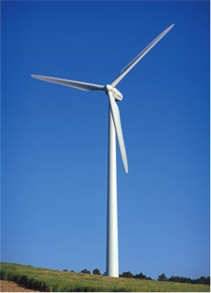
FAST
Solves aero-hydro-servo-elastic dynamics for an individual wind turbine
One instance per rotor
Subcycled
Wrapper for FAST v8:
Similar to FAST v8 wrapper for SOWFA, but different outputs
FAST v8 has many modules
Inputs:
Commands from super controller
Disturbed wind speed (ambient + deficits) around rotor
Outputs:
Commands to super controller
Position of hub
Orientation of rotor centerline
Rotor diameter
Rotor disk-avg. relative wind speed (ambient + deficits + motion), normal to disk
Azimuth-avg. normal-force coef., distributed radially
FAST
States:
Many
Parameters:
Many

Slide 10
Wake Deficit
Calculates quasi-static axisymmetric wake deficit for an individual rotor
One instance per rotor
Wake Deficit
Inputs:
Ambient TI
Downwind increments of wake planes
Rotor disk-avg. ambient wind speed of wake planes, normal to wake planes
Rotor diameter
Rotor disk-avg. relative wind speed (ambient + deficits + motion), normal to disk
Azimuth-avg. normal-force coef., distributed radially
Discrete States:
Axial & radial wake deficits @ wake planes, distributed radially
Parameters:
# of wake planes
Radial finite- difference discretization
Outputs:
Discrete states
Wake diameters @ wake planes

Slide 11
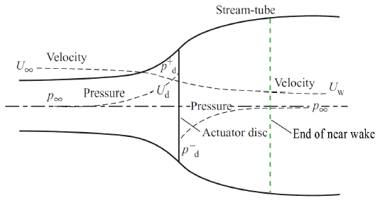
Near-Wake Correction
Calculates near-wake (pressure-gradient-zone) correction to wake deficit for an individual rotor
Subroutine, rather than a module
Needed to avoid a rotor
interacting with its own wake;
may need to adjust existing
CFD-calibrated parameters to
compensate
Near-Wake
Correction
Inputs:
Rotor diameter
Rotor disk-avg. ambient wind speed, normal to disk
Rotor disk-avg. relative wind speed (ambient + deficits + motion), normal to disk
Azimuth-avg. normal-force coef., distributed radially
States:
N/A
Parameters:
Radial finite- difference discretization
2 CFD-calibrated parameters
Outputs:
Axial & radial wake deficits just downstream of rotor disk, distributed radially

Slide 12
Wake-Deficit Increment
Increments the quasi-static axisymmetric wake deficit downwind for an individual rotor
Subroutine, rather than a module
Wake-Deficit
Increment
Inputs:
Ambient TI
Downwind increment
Rotor disk-avg. ambient wind speed, normal to wake plane
Axial & radial wake velocity deficits @ a wake plane, distributed radially
States:
N/A
Parameters:
Radial finite- difference discretization
4 CFD-calibrated parameters
Outputs:
Axial & radial wake deficits @ a wake plane incremented downwind, distributed radially

Slide 13
Wake Advection, Deflection, & Meandering
Solves dynamic wake advection, deflection, & meandering for an individual rotor
One instance per rotor
Step change
in yaw
Time
Wake Deflection
Wake Meandering
Wake Advection

Slide 14
Wake Advection, Deflection, & Meandering
Wake Advection, Deflection, & Meandering
Inputs:
Disturbed wind speed (ambient + deficits) throughout domain
Position of hub
Orientation of rotor centerline
Ambient wind speed around rotor
Wake diameters @ wake planes
Rotor inputs:
Rotor diameter
Rotor disk-avg. relative wind speed (ambient + deficits + motion), normal to disk
Azimuth-avg. normal force coef., distributed radially
Discrete States:
Center positions of wake planes
Orientations of wake planes
Rotor disk-avg. ambient wind speed of wake planes, normal to wake planes
Time-filtered rotor inputs
Parameters:
# of wake planes
Time step
Low-pass filter parameter(s)
Outputs:
Discrete states
Downwind increments of wake planes

Slide 15
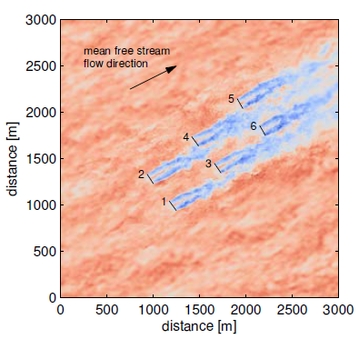
Wake Merging
Identifies zones of wake overlap between all wakes across wind farm & merges their wake deficits:
Superimpose wake deficits in local wind direction based on root-sum-square method & transverse components vectorally
NOTE: Near-wake zones are not accurate
Wake Merging
Inputs:
Ambient wind speed throughout domain
Center positions of wake planes
Orientations of wake planes
Axial & radial wake deficits @ wake planes, distributed radially
States:
N/A
Parameters:
Spatial discretization
# of turbines
# of wake planes
Radial finite- difference discretization
Outputs:
Disturbed wind speed (ambient + deficits) throughout domain

Slide 16
FAST.Farm Inputs & Outputs

Slide 17
Q & A

Slide 19
FAST.Farm Submodel Hierarchy
OLD
Proposed changes:
*Add a wake-deficit block and move near-wake correction, axisymmetric wake deficit into it
*Start wake deficit 0.5*D downwind from rotor to avoid the wake of a turbine effecting its own inflow:
-Wake is not accurate in near wake region anway
-May need to adjust CFD-derived calibration parameters
*Change wake impingement to wake merging and apply consistently across all of the domain, which allows one to access disturbed wind throughout domain, which is another limitation of existing DWM methods:
-Wakes are superimposed via RSS along local wind direction
-Wakes are superimposed vectorally normal to local wind
-Added turbulence should be a submodel of wake merging, not wake deficit
*Note: Merged wake is not accurate in near-wake regions because individual wake deficits are not accurate in near-wake regiions anway

Slide 20
OLDER

Slide 21
Work Plan
Tasks and Deliverables | Responsible Team Members
Task 0 – Project Management Track and report on the progress of the project. | Jason Jonkman, Pat Moriarty
Task 1 – Tool Development Run SOWFA simulations to facilitate model development. Develop theoretical formulation of the wake and array submodels. Implement the new models in source code. Document the tool theory and user guidance. | Matt Churchfield, Pieter Gebraad, Bonnie Jonkman, Jason Jonkman, Sang Lee, Avi Purkayastha
Task 2 – Tool Validation Analyze the idealistic land-based wind plant. Analyze the Egmond aan Zee offshore wind plant. Document the results. | Matt Churchfield, Pieter Gebraad, Jason Jonkman, Sang Lee
Task 3 – Wind-Plant Controls Design Application Write a concept paper proposing a strategy to apply the tool to simultaneous performance and load control and predicting the expected benefits. | Paul Fleming, Pieter Gebraad
Work Plan

Slide 22
Resources / Costs
Team Members | FY16 FTE Months | FY17 FTE Months
Matt Churchfield (NWTC) – SOWFA for tool development & V&V | 1.20 | 1.20
Paul Fleming (NWTC) – Controls | 0.20 | 0.45
Pieter Gebraad (NWTC) – Tool development, V&V, & controls | 2.00 | 2.00
Bonnie Jonkman (NWTC) – Programming support | 1.50 | 1.50
Jason Jonkman (NWTC) – PI, tool development, & V&V | 3.00 | 3.00
Sang Lee (NWTC) – SOWFA for tool development & V&V | 2.40 | 2.40
Pat Moriarty (NWTC) – Advisor | 0.20 | 0.20
Avi Purkayastha (CSC) – Programming support | 0.75 | 0.75
Total | 11.25 | 11.50
Category | FY16 | FY17
Loaded Labor | $274,755 | $292,290
Loaded Recharges | $0 | $2,000
Loaded ODC | $4,845 | $5,710
Total | $279,600 | $300,000
SOWFA simulations provided 150,000 node-hours on NREL’s Peregrine HPC in FY16

Slide 23
Recent Progress on Approach
Base wake – Take the approach used in FLORIS/FLORIDyn, but modified so that the base wake is smoothed (e.g., Gaussian profile) instead of stepped. Note that the FLORIS/FLORIDyn model handles:
Axisymmetric wake deficit
Wake shape / redirection as a result of yaw/tilt
Wake skew as a result of veer
Wake propagation (transients) as a result of time-varying thrust/controls
Calibrated to match SOWFA.
Wake merging – FLORIS/FLORIDyn uses an approach, but this may need to be reconsidered; basically, we need a way to spatially average intersecting wakes.
Wake meandering – Use passive tracer based on background flow derived from ABLSolver; the wake should move slower than the mean wind speed.

Slide 24
Recent Progress on Approach
Complex-terrain effects – The assumptions is this will happen naturally through the wake meandering process based on background flow from ABLSolver, but this may need to be reconsidered.
Wake-added turbulence – Not yet discussed.
Turbulent wake edge (deformation of the wake profile) – Could potentially be addressed using a passive-tracer approach, but pushed to future work.
Software platform – We’ll have to decide in the future whether the software should be coded up as a new package or as a new module within OpenFOAM.

Slide 25
Recent Progress on Approach
We considered the following alternatives to those selected above, but ultimately chose against them for various reasons.
Approach | Reason to Drop
Develop the base wake as is currently done in DWM (thin-shear-layer form of NS) | Too many limitations (no wake skew/deflection, no evolution, etc.)
Use TurbSim for background turbulence | Limitations for plant-wide flow and complex terrain
Use RANS to derive the base wake of the entire plant (including wake merging) | Computationally expensive and not sure how to meander a plant-wide wake
Use URANS (computationally between RANS and LES) instead of DWM approach | Computationally expensive and quite different than the proposal to build from DWM; may be useful side project in the future to verify what accuracy can be obtained
Use a vortex method | Computationally expensive and not proven to work in the far wake
Use a stochastic model of wake meandering instead of a passive tracer approach | It is desired to have physics based on background turbulence, not a synthetic reconstruction of SOWFA simulations

Slide 26
Wake Phenomena

Slide 27
SOWFA Sims to Support Model Development

Slide 28
Software Name
Possibilities
FAST-WP or FAST-WF (Jason)
FAST.Farm (Jason)
WP-Engineering or WF-Engineering (Jason)
FarmSim (Paul)
FarmDyn (Paul)
Other suggestions?

Slide 29
Background
Wind research direction changing focus from wind turbine (WT) to wind plant (WP):
Wind industry plagued by underperformance, failures, & expenses
Improvements required in WP performance & reliability, together with reduced uncertainty & expenditures to achieve CoE targets
Improvements eluded by complicated nature of WP design, especially interaction between atmospheric phenomena & wake/array effects
Current DOE funding focused on high-fidelity modeling (HFM) & experiments, not engineering methods needed to enable design innovations
Range of WP tools exist, but none fully meet engineering needs:
FLORIS: Steady state with no dynamics or WT loads [Gebraad et al 2014]
DWM: Serial solution limits accuracy & usefulness [Hao et al 2014]
SOWFA: High resource demand means very few simulations
Example SOWFA Simulation [Churchfield et al 2012]

Slide 30

Objective
LDRD will develop, validate, & demonstrate a new multi-physics tool applicable to WP engineering problems in research & industry:
Capture relevant physics accurately
Maintain computational speed to support iterative & probabilistic design
Be DWM-like, using FAST & modeling wake meander as passive tracer
Avoid limitations of other tools & bridge their differences in fidelity
Unique innovations – a game-changing paradigm in WP engineering:
Reformulate various submodels from HFM insight
Introduce new model for wake evolution & merging
Solve entire WP in parallel on HPC
WP applications:
Reducing underperformance & loads uncertainty
Controls enhancement to improve operation
Siting & topology optimization
Better design of WTs for WP environment
Photo by Alstom 2010, NREL 18207

Slide 31
Planned Approach
1) Tool development:
Run well-validated SOWFA to facilitate submodel creation & parameter calibration
Develop new parallelized time-domain wake-deficit model with:
Wake evolution – Wake skew/deflection
Wake merging – Wake-added turbulence
Use precursor atmospheric simulation (ABLSolver module of SOWFA) to account for stability & complex terrain effects as driver for wake meandering
Solve each FAST instance on separate cores & interconnect through MPI
Require modest HPC (100s of cores) not out of reach of industry use
Document, make open source, & publicly release
New Multi-Physics Engineering Tool for WP Design & Analysis

Slide 32

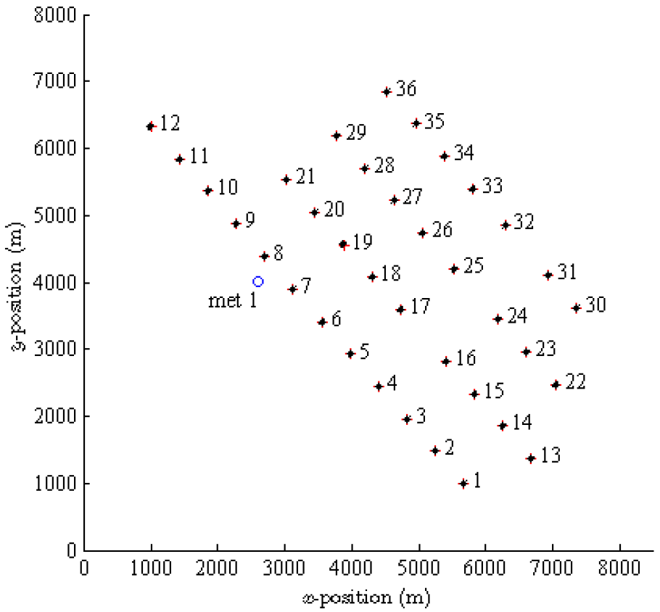
Planned Approach
2) Tool verification & validation (V&V):
Compare FLORIS, DWM, new tool, SOWFA, & measured data for 2 cases:
Small/idealistic WP of 6 Vestas V90 3-MW WTs in 2×3 grid (SOWFA only)
Egmond aan Zee (OWEZ) WP of 36 V90 3-MW WTs (SOWFA & measured data)
Verify accuracy, demonstrate improvement over other tools, & identify future needs
3) WP controls-design application:
Develop WP control strategy based on modifying wake deficits & redirecting wakes to achieve global benefit of improving performance & reducing loads:
For both idealistic 2×3 & OWEZ WPs
Compare to conventional strategy considering performance only to prove new strategy & demonstrate tool’s unique capability
OWEZ Offshore WP
[Churchfield et al 2014]

Slide 33
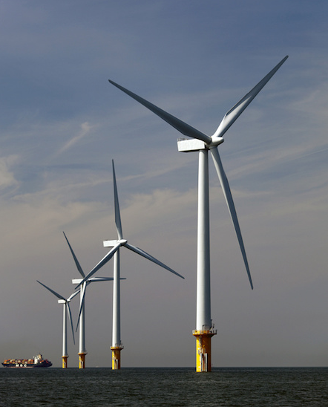
Plans for Follow-on Funding
Successful LDRD outcome will not only position NREL as WP design & analysis leader, but it will create a paradigm shift in WP design capability & drive significant interest & funding from DOE & industry:
Link to DOE Atmosphere-to-Electrons (A2e):
Integrated WP control
Reliability
Integrated system design & analysis
Address industry problems involving WP performance & cost optimization
Generate innovations with IP & patents
Potential future development pathways:
Interface to WISDEMTM for systems engineering applications (MDAO, UQ, etc.)
Address unique offshore challenges (air-water interface)
Expand to undersea marine turbine arrays
Form basis for future WP engineering tool advances as WP physics knowledge grows from future computations & experiments
Photo by Siemens AG, NREL 27821

Slide 34
References
Churchfield, M.J.; Lee, S.; Moriarty, P.J.; Martinez, L.A.; Leonardi, S.; Vijayakumar, G.; and Brasseur, J.G. (January 2012). “A Large-Eddy Simulation of Wind-Plant Aerodynamics.” Preprint. Prepared for the 50th AIAA Aerospace Sciences Meeting, Jan. 9-12, 2012. NREL/CP-5000-53554. Golden, CO: National Renewable Energy Laboratory, 19 pp. Accessed Jan. 29, 2015: http://www.nrel.gov/docs/fy12osti/53554.pdf.
Churchfield, M.J.; Moriarty, P.J.; Hao, Y.; Lackner, M.A.; Barthelmie, R.; Lundquist, J.; and Oxley, G.S. (December 2014). “A Comparison of the Dynamic Wake Meandering Model, Large-Eddy Simulation, and Field Data at the Egmond aan Zee Offshore Wind Plant.” Preprint. Prepared for the AIAA SciTech Forum and Exposition, Jan. 5-9, 2015. NREL/CP-5000-63321. Golden, CO: National Renewable Energy Laboratory, 22 pp. Accessed Jan. 29, 2015: http://www.nrel.gov/docs/fy15osti/63321.pdf.
Gebraad, P.M.O.; Teeuwisse, F.W.; van Wingerden, J.W.; Fleming, P.A.; Ruben, S.D.; Marden, J.R.; and Pao, L.Y. (December 2014). “Wind Plant Power Optimization Through Yaw Control Using a Parametric Model for Wake Effects – a CFD Simulation Study.” Wind Energy. 20 pp. DOI: 10.1002/we.1822.
Hao, Y.; Lackner, M.A.; Keck, R.E.; Lee, S.; Churchfield, M.J.; Moriarty, P. (January 2014). “Implementing the Dynamic Wake Meandering Model in the NWTC Design Codes.” Proceedings of the AIAA SciTech Forum and Exposition, Jan. 13-17, 2014. NREL/CP-5000-61115. 19 pp. Accessed Jan. 29, 2015: http://dx.doi.org/10.2514/6.2014-1089.

